Slide 1



Smart Barrier
Automated Vehicle Entry System

Slide 2

Smart Barrier
Programming - Members
Bharat Choudhary (21ECTCS007)
1
Team Members
Shubham Paliwall (21ECTCS037)
2
3D Animation - Members
University College of Engineering and Tehnology
Karan Soni (21ECTCS012)
3
Hardware - Members
Ranu Soni (21ECTCS027)
4
Documantion - Members
Narendra Sharma (21ECTCS022)
4

Slide 3



Overview
Briefly introduce the problem of manually operated gates and the need for automation.
Introduction
Current Scenario:
Manual gate operation and vehicle number registration.
Proposed Solution
Automation using machine learning, OpenCV, and Arduino.

Slide 4

Primary Objective
To automate the college gate operation using a smart barrier system.
Sub-objectives
Elaborate on what you want to discuss.
Objectives
Detect vehicles using a camera.
Recognize and read the vehicle number plate using OCR
Store the vehicle number and details in an Excel sheet
Automatically open/close the gate based on vehicle detection. Ensure safety using ultrasonic sensors

Slide 5







Camera for vehicle detection
Bluetooth module for communication
System Architecture
Arduino for gate control.
Ultrasonic sensor for safety

Slide 6



Technology Stack
Technology | Technology For
Machine Learning & OpenCV | For vehicle detection and OCR.
Arduino | For hardware control.
Bluetooth Communication | Between software and hardware.
Excel/Database | For storing vehicle information.
Ultrasonic Sensors | For obstacle detection.

Slide 7
System Workflow
A
Vehicle approaches the gate.
B
Camera detects and captures the image.
E
Signal sent to Arduino via Bluetooth.
D
Data stored in the Excel sheet.
C
OCR extracts the vehicle number.
E
Ultrasonic sensor ensures safety.
F
Gate opens automatically.

Slide 8











Advantages & Benefits
Automation: Reduces manual effort and errors
Security: Enhances vehicle tracking and data management
Efficiency: Faster processing and gate operation
Safety: Ensures no accidents with the ultrasonic sensor

Slide 9

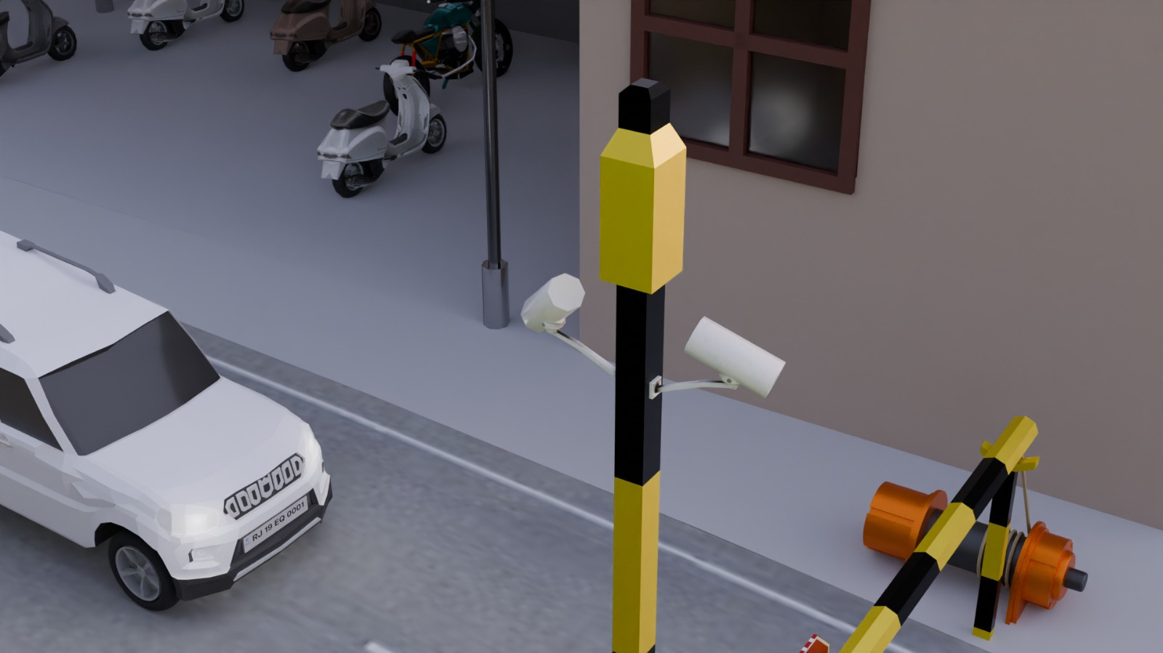
Camera
Extract vehicle number from captured image.
And image sent for OCR (Optical Character Recognition) processing.

Slide 10
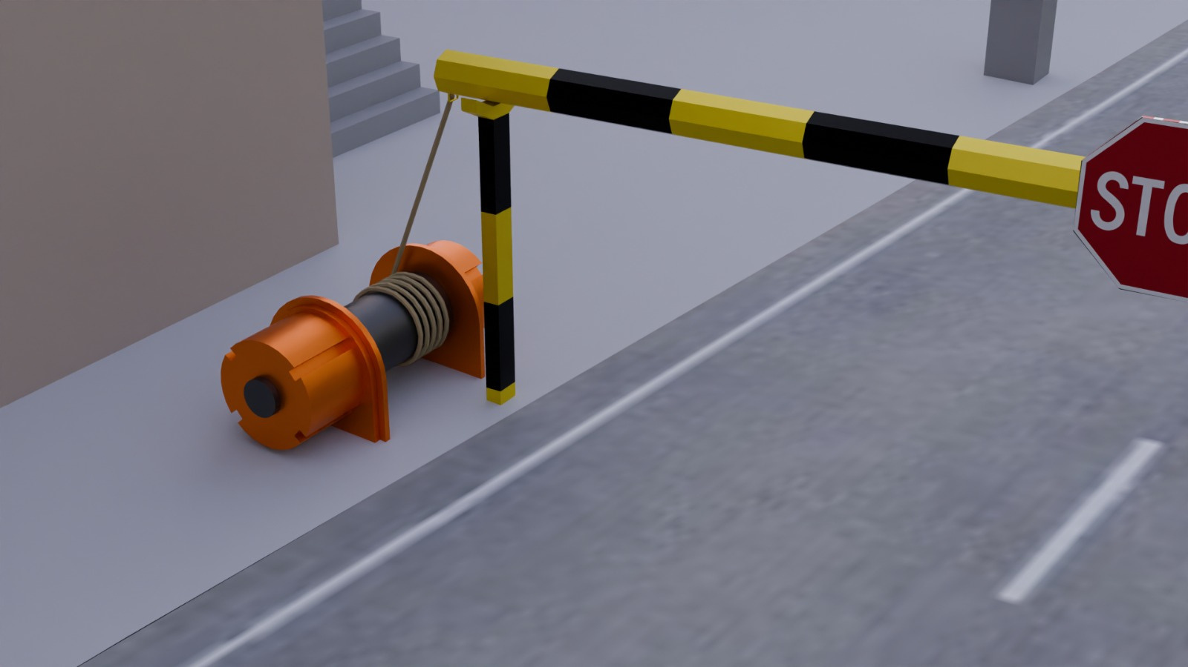
Motor
High signal received -> Motor operates -> Gate opens/closes.

Slide 11
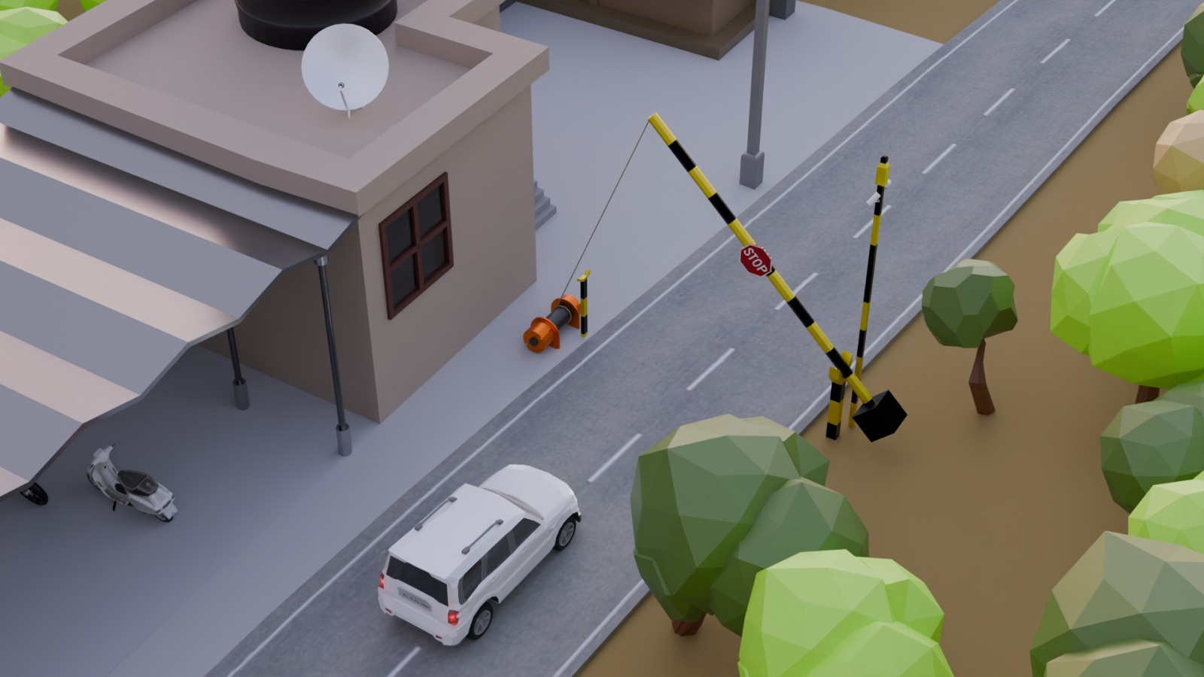
COMPLETER 3D OVERVIEW OF THE SMART BARRIER

